Slide 1

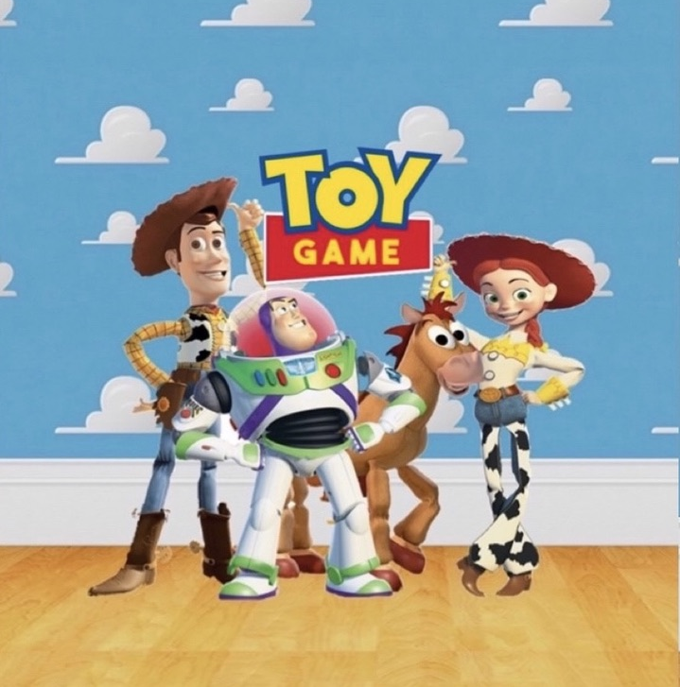
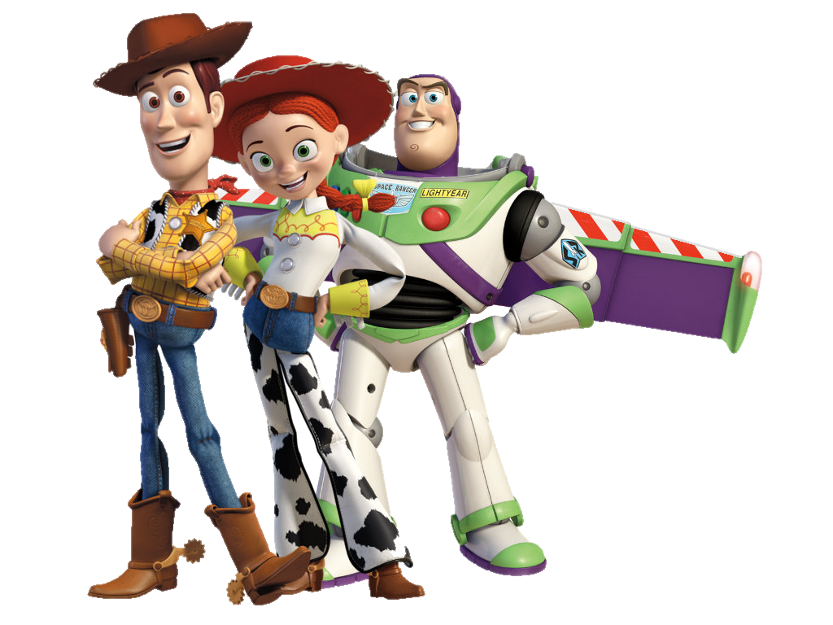
TOY
GAME
Group #6

Slide 2
DESIGN THINKING STAGES
5
TEST
4
PROTOTYPE
3
IDEATE
2
DEFINE
1
EMPATHIZE

Slide 3
STAGE 1
EMPATHIZE
We made the empathy map
based on the empathy post
After gathering the information from the interviwe we deduce the empathy
EMPATHY MAP
EMPATHY POST
INTERVIWES
We interviwed a mother, pediatric nutrition specialist and two under 6 years old children

Slide 4

EMPATHY MAP
SAYS
- “I don’t like to eat healthy food.”
- “I like playing on my iPad because there are so many games. That is not like boring physical games. “
- “I eat pancakes with nutella and berries.”
- It's not easy to learn new habits.
- It’s difficult to resist sweets and junk food.
- Educational games are boring and not as interesting as trendy games.
- Food is more enjoyable while watching TV.
THINKS
DOES
- Eat my food in different types of - dishes.
- Helping with the housework.
- Play trendy games and watch TV.
FEELS
- They are afraid, worried, and scared

Slide 5
STAGE 2
Application that is suitable, easy and clear for children under 6 years old.
Make the learning process educational yet entertaining.
An attractive, creative and distinctive application that is interactive and full of colors as well as having some sounds or background music.
Competitive games for good eating and exercising habits.
NEEDS
Teaches about the human body that will expand their knowledge.
Playing active games with other children by encouraging them to have a healthier physical body.
Games that help the child to use his senses and keeps him engaged visually, orally and even intellectually.
Developing thinking skills and decision making.
INSIGHTS

Slide 6
PROBLEM STATEMENT
Preschool children need to be motivated to learn about senses, as well as eating and exercising habits, because they are affected by the external environment and most games are no longer as educational as they are entertaining. Therefore, verbal gaudiness may be not sufficient alone and they need visual assistance like body language and simplified signs.

Slide 7
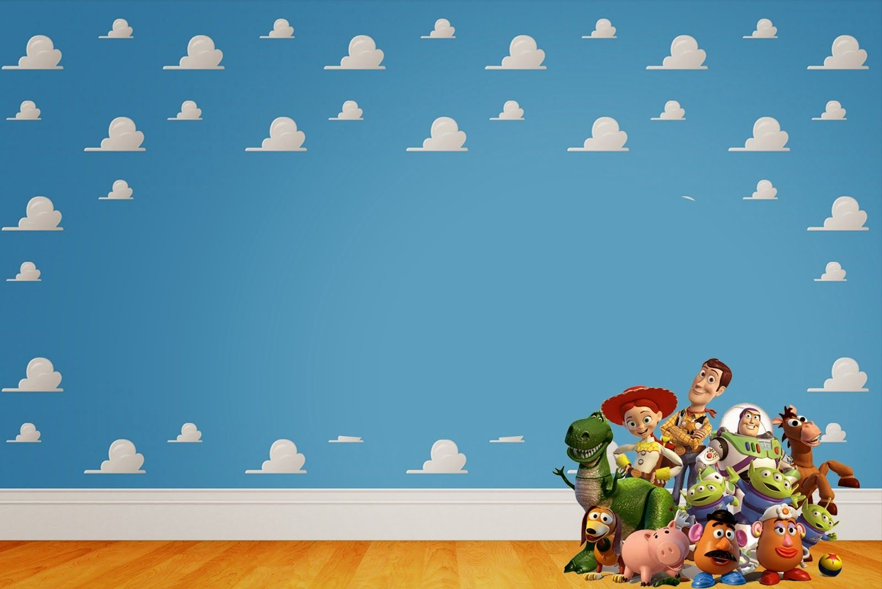

STAGE 3
IDEATE
Change the clothes of the character to make them suitable for the place and
time.
Can pause and resume the game anytime.
Record our voices to make the game interesting.
.Can play the game online with friends or family
Include colors and make a creative attracting theme.
Add score and ranking.
Make the game story-like.

Slide 8

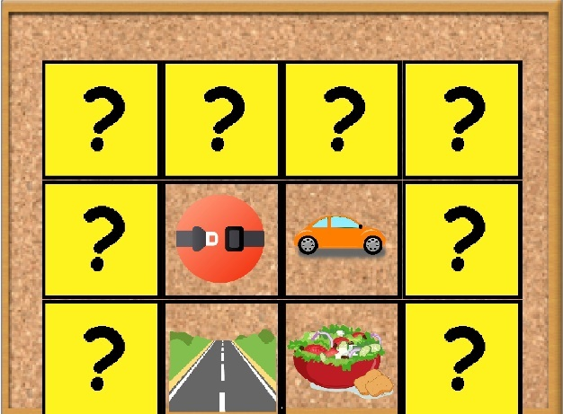
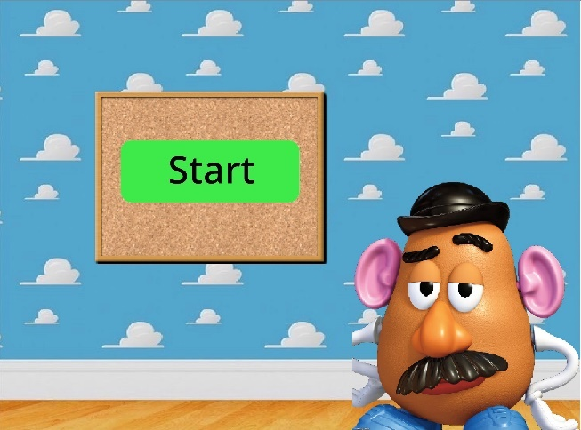
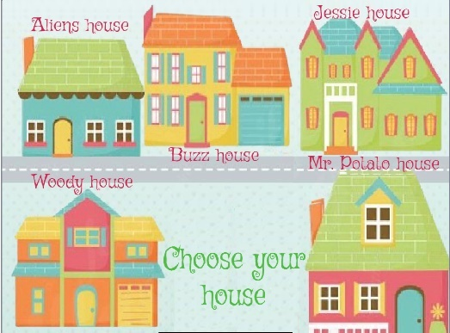
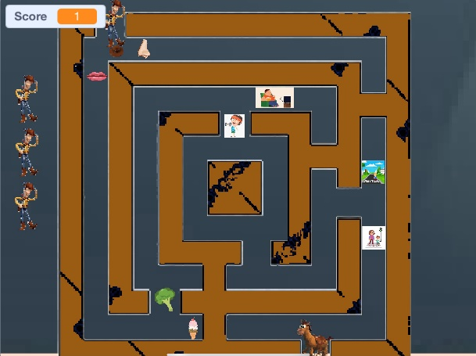
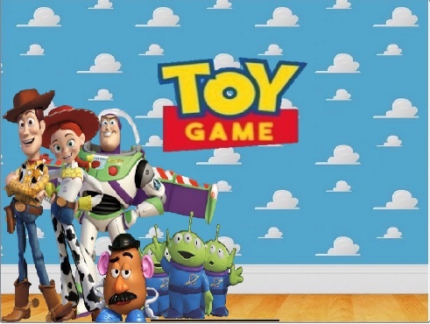
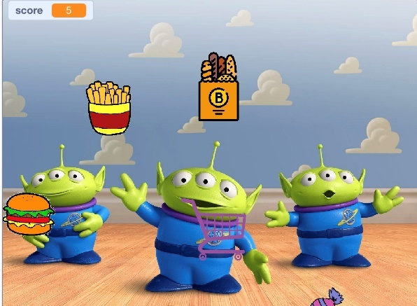
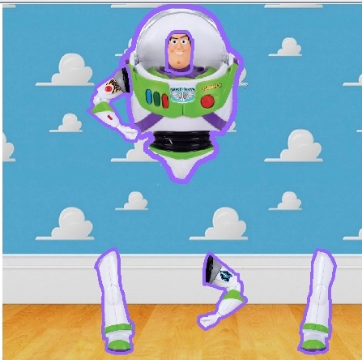
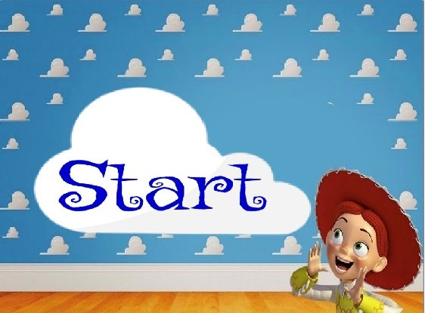
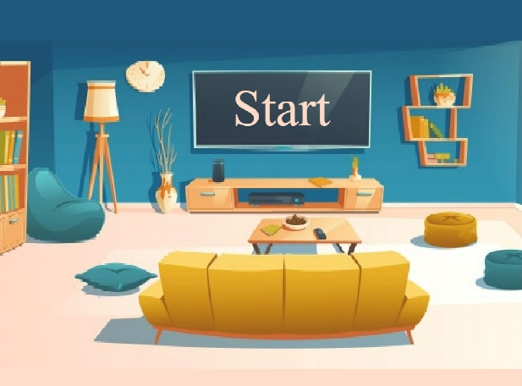
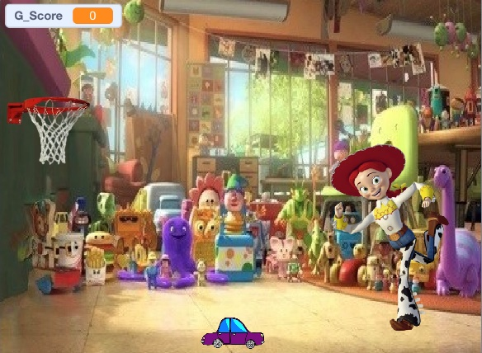
STAGE 4
PROTOTYPE

Slide 9
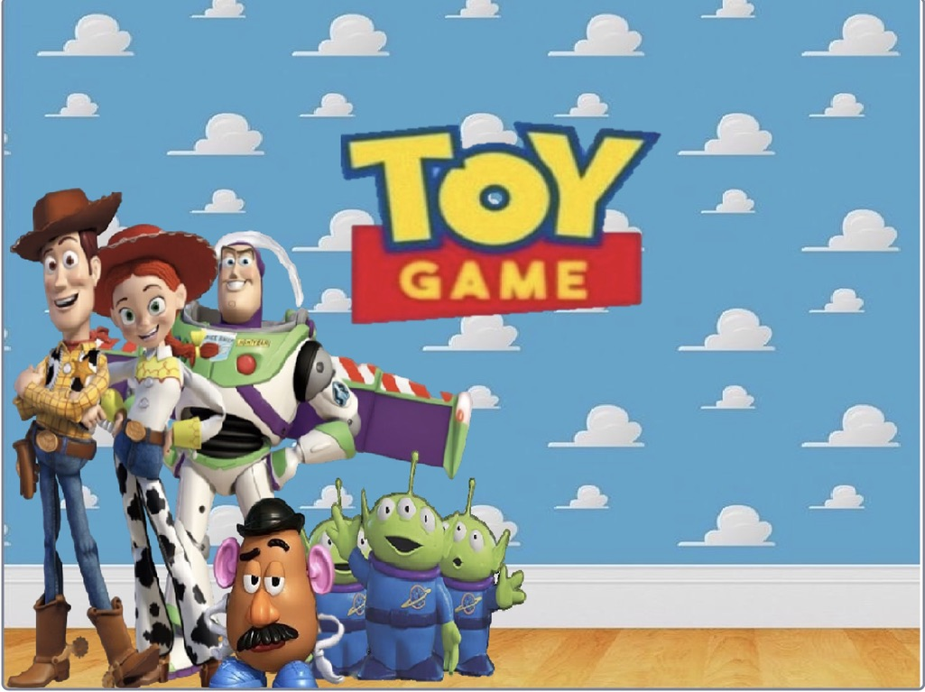
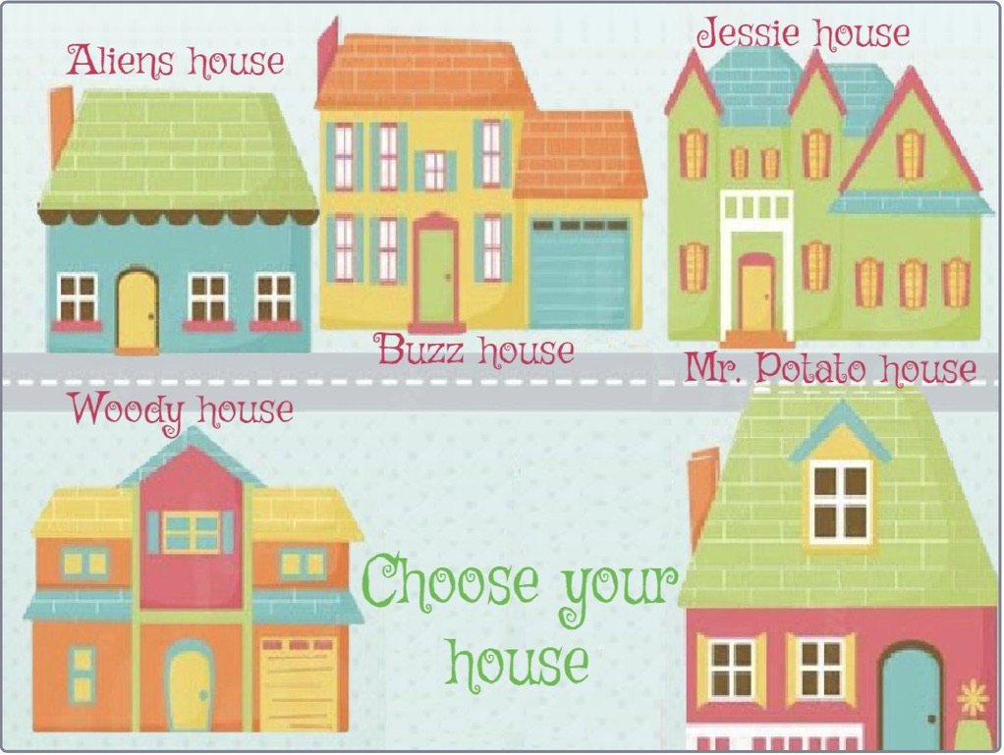
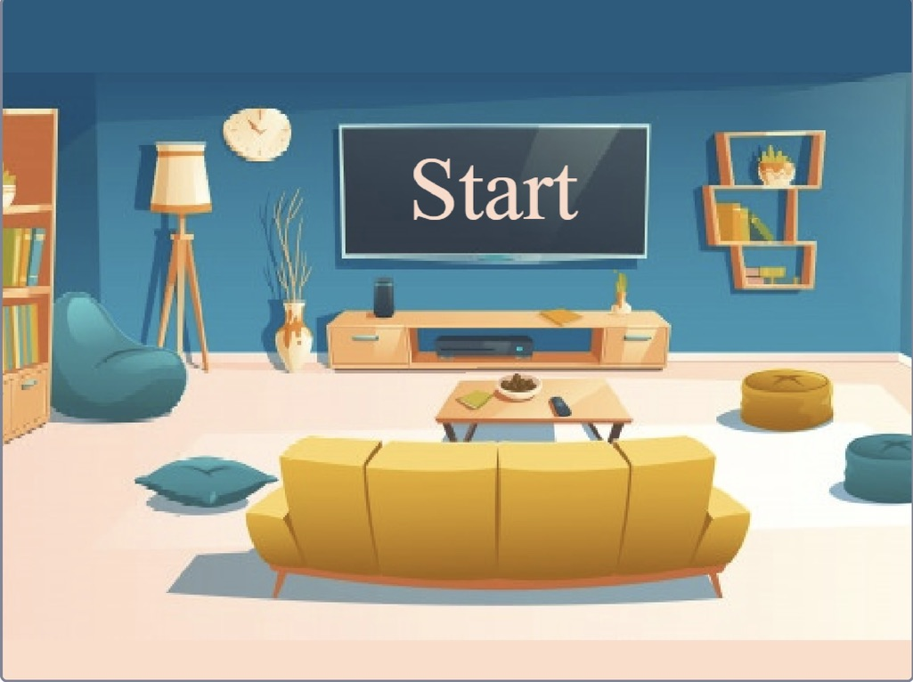
FINAL GAME

Slide 10
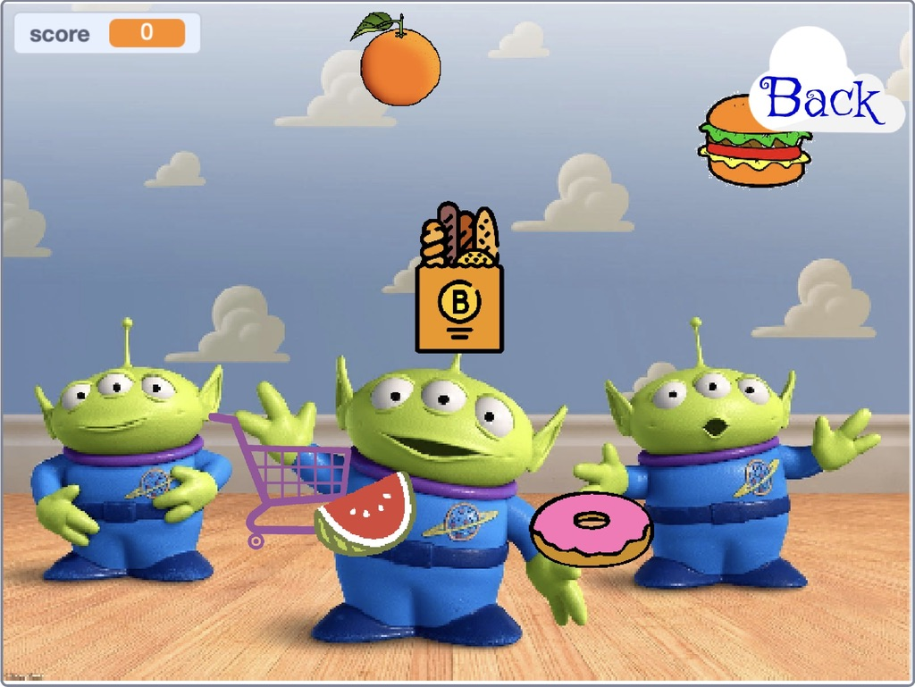
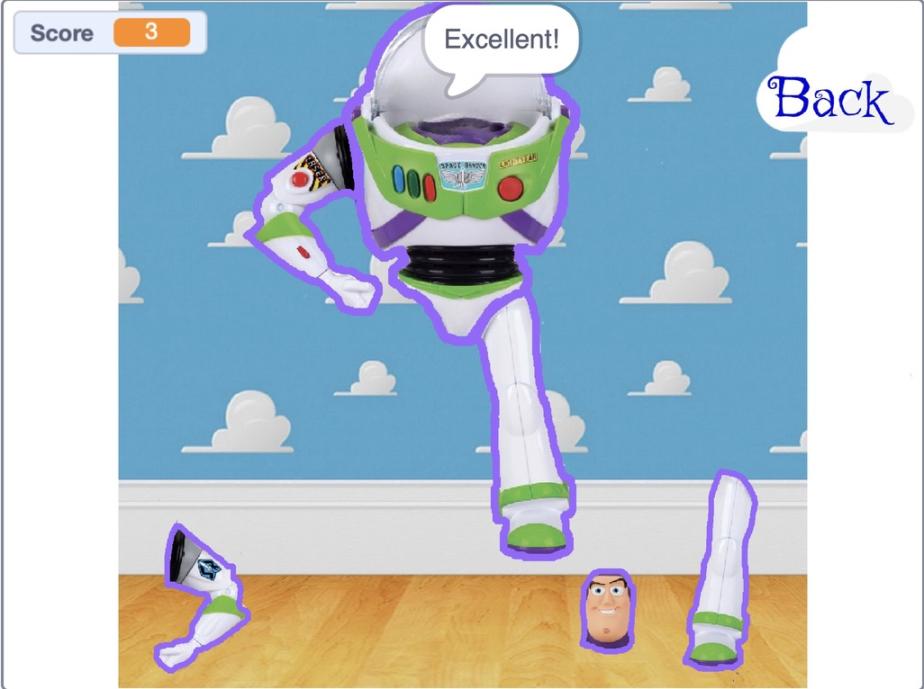
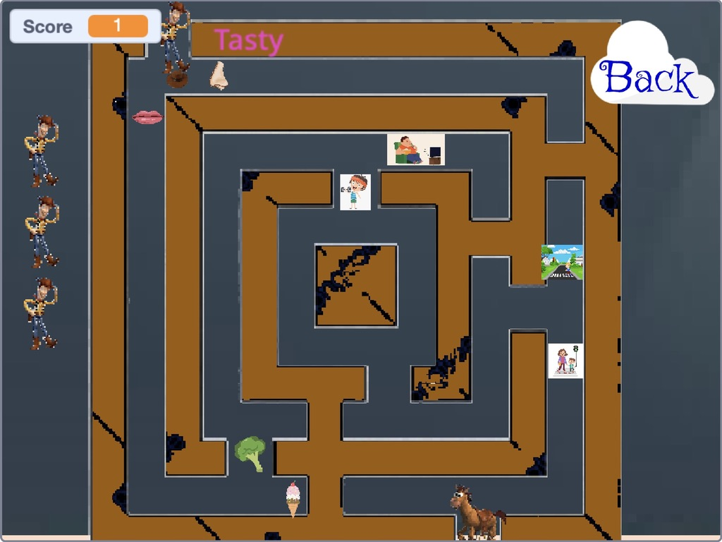
FINAL GAME

Slide 11
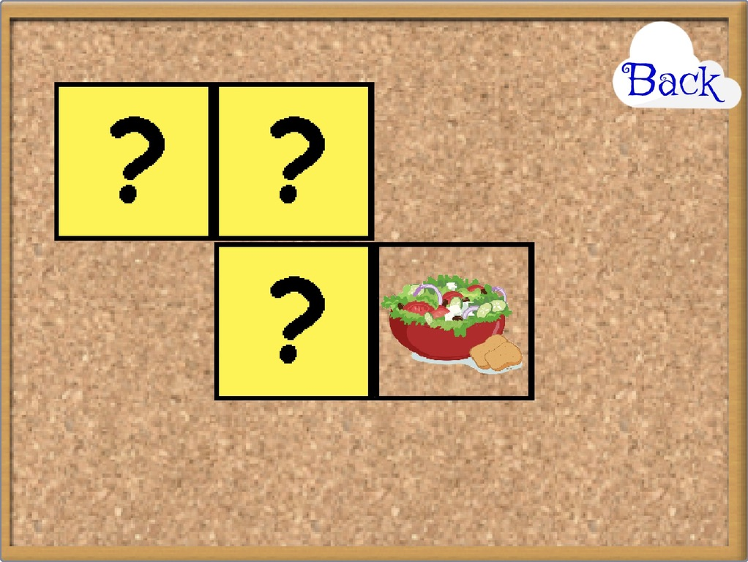
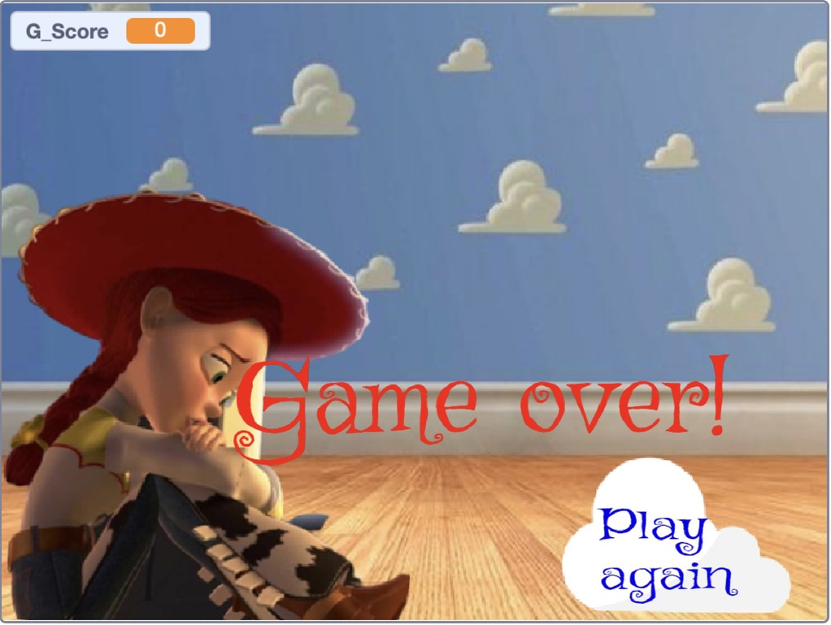
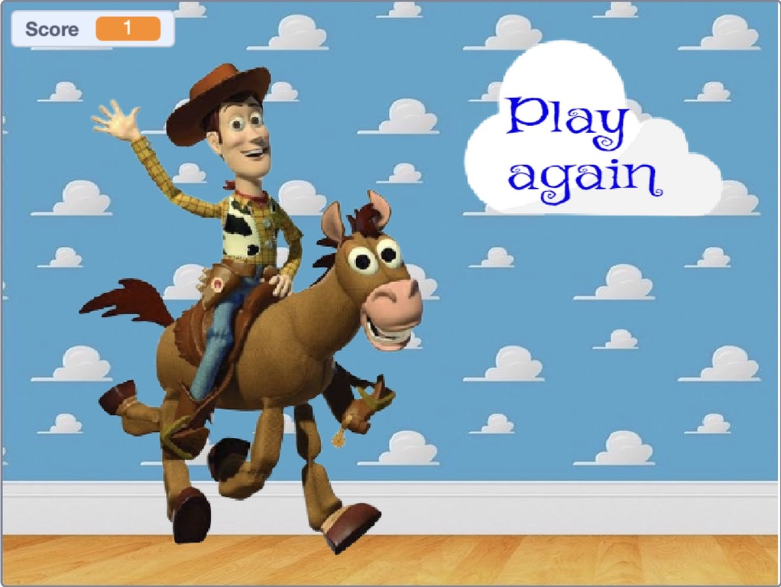
FINAL GAME

Slide 12

STAGE 5
TEST
- Adding levels and stages.
-Adding more games.
-make it an online game.
-Improve the resolution of pictures.
-Adding quizzes to check their
understanding.
-Add more languages.
-Add variety of exercises.
-Add versions suitable for different ages.
-Improving the game.
-Can pause and resume the game
anytime.
-Add multi-playing option.
What
could be proved?
Ideas?
-Did it work smoothly and was it
understood by the child easily?
-Will the game be suitable for children
greater than 6 years old?
-Is the theme suitable and likable by all
children?
What Worked?
Questions?
- Enjoyable learning.
-Teaching the child health and fitness
through making different teaching
techniques in the form of interesting games.
-Sounds and an attractive theme.

Slide 13
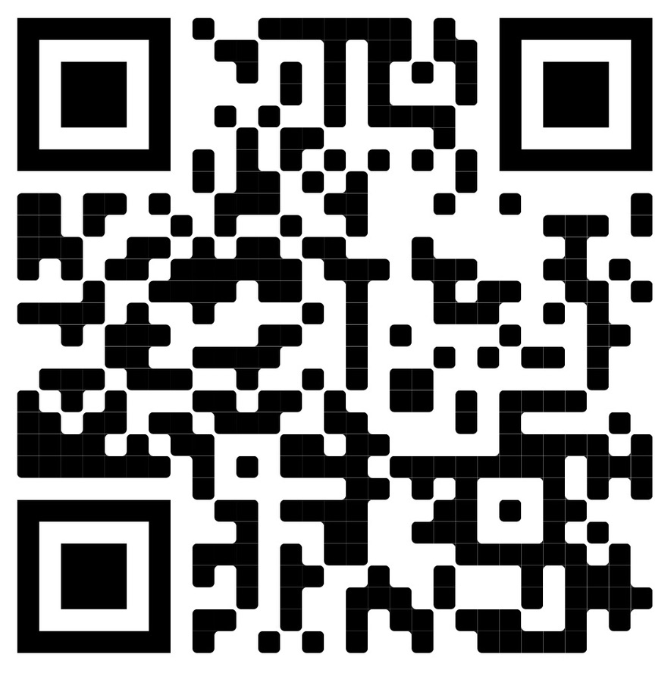
THANKS !
for listening
GAME’S LINK

Slide 14
THANK YOU
BASMA ALAMOUD

